Slide 1
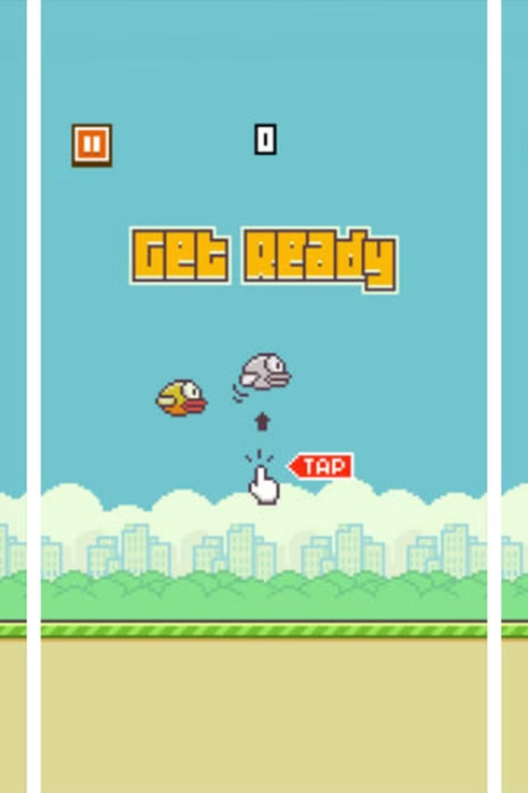
FLAPPY BIRD: A DIVE INTO GAME DEVELOPMENT USING PYGAME
Group Members
Rahma Taieb 23pwcse2291
Marwa Rafique 23pwcse2304
Fatima Innayat 23pwcse2266

Slide 2
GAME INITIALIZATION: SETTING THE STAGE
Importing Libraries
Initializing Pygame
The game begins by importing necessary libraries, including Pygame for graphics and sound, and modules for time management and game objects.
Pygame is initialized, including the mixer for sound effects. The game window is set up with specified dimensions and a scale factor for visual adjustments.

Slide 3
GAME OBJECTS: THE PLAYERS
BIRD CLASS
PIPE CLASS
The Bird class defines the bird's behavior, including flapping, gravity, and collision detection. It handles the bird's movement and interaction with the game environment.
The Pipe class manages the pipes, including their generation, movement, and collision detection. It ensures a continuous flow of obstacles for the bird to navigate.

Slide 4
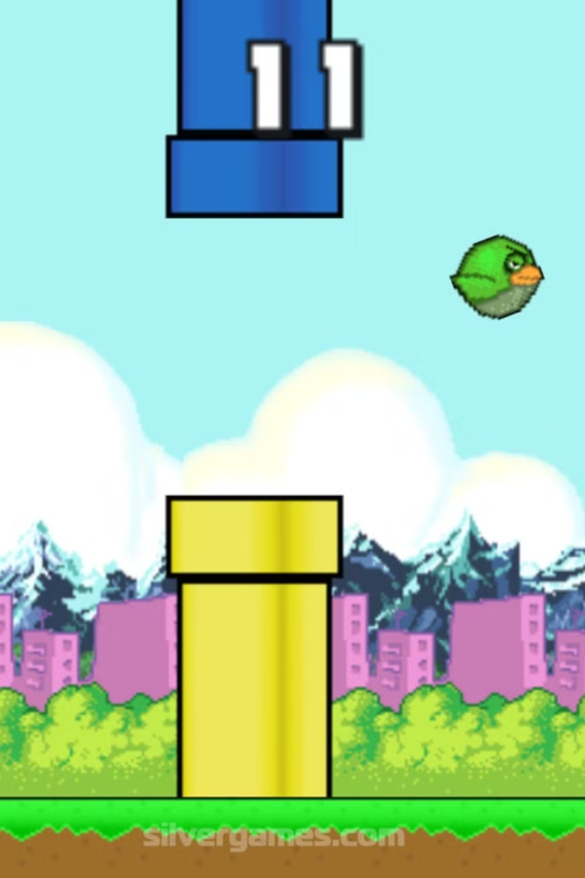
GAME MECHANICS: THE RULES OF THE GAME
1
Score
2
Collision Detection
The player's score increases as the bird passes through each pipe. The game tracks the score and displays it on the screen.
The game checks for collisions between the bird and the pipes or the top and bottom of the screen. If a collision occurs, the game ends.
3
Game Loop
The game loop continuously updates the game state, handles events, and renders the game graphics. It ensures smooth gameplay and responsiveness.

Slide 5
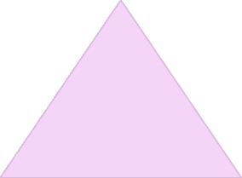


PHYSICS IN FLAPPY BIRD: THE SSIENCE OF FLIGHT
Gravity
1
The bird is constantly affected by gravity, pulling it downwards. This force is represented by a constant acceleration value.
Flap Force
2
When the player flaps the bird's wings, an upward force is applied, counteracting gravity. This force is determined by the bird's flap strength.
Velocity
3
The bird's velocity is its speed and direction. It is affected by the forces of gravity and flap force, resulting in the bird's movement.

Slide 6

LEVEL SELECTION:CHOOSING YOUR CHALLENGE
Simple
Medium
The simple level offers a slower pace, with slower pipe movement, a weaker bird flap, and a larger gap between pipes.
The medium level provides a balanced challenge, with moderate pipe movement, a normal bird flap, and a medium gap between pipes.
Hard
The hard level presents the most demanding challenge, with faster pipe movement, a stronger bird flap, and a smaller gap between pipes.

Slide 7
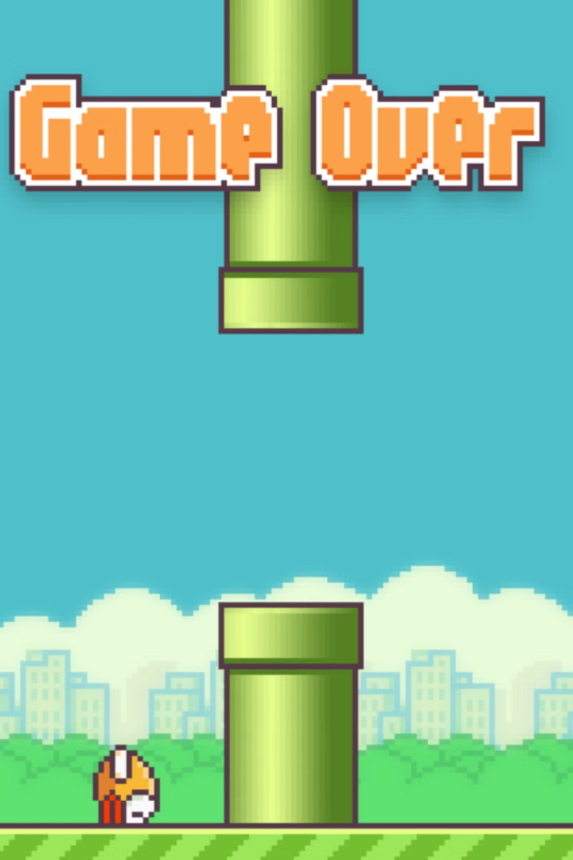


GAME OVER: RESTARTING THE JORNEY
Reset
Score
When the game ends, the player can restart the game by pressing the Enter key or clicking the restart button.
The player's final score is displayed on the game over screen, allowing them to track their progress and strive for higher scores.

Slide 8
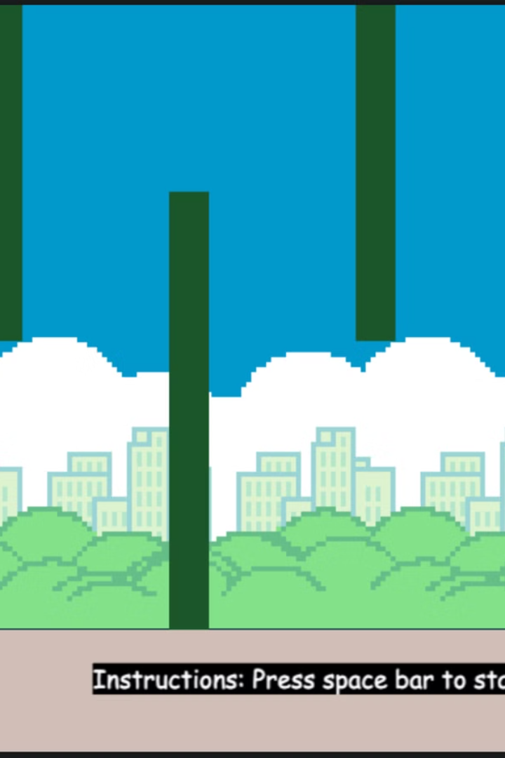
Sound Effects: Enhancing the Experience
1
Flap
A flapping sound effect plays when the player flaps the bird's wings, adding a sense of realism and immersion.
2
Score
A scoring sound effect plays when the bird passes through a pipe, providing auditory feedback for the player's progress.
3
Game Over
A game over sound effect plays when the bird collides with an obstacle, signaling the end of the game.

Slide 9

OBJECT-ORIENTED PROGRAMMING IN PYTHON: A FLAPPY BIRD EXAMPLE
In this we'll delve into how OOP principles like classes, objects, inheritance, and polymorphism enhance code organization, reusability, and maintainability.

Slide 10
OOP: A PARADIGM SHIFT
Data Abstraction
Code Reusability
OOP focuses on representing data as objects, encapsulating data and behavior within a single unit. This promotes modularity and reduces code complexity.
Classes serve as blueprints for creating objects, allowing for the creation of multiple instances with shared characteristics and behaviors. This reduces code duplication and promotes maintainability.

Slide 11

CLASSES: THE BUILDING BLOCKS
Bird Class
Pipe Class
Represents the bird, encapsulating its attributes (position, velocity) and methods (flap, update).
Represents a pipe, encapsulating its attributes (position, gap) and methods (draw, update).
Game Class
Represents the overall game, managing game logic, rendering, and user interaction.

Slide 12
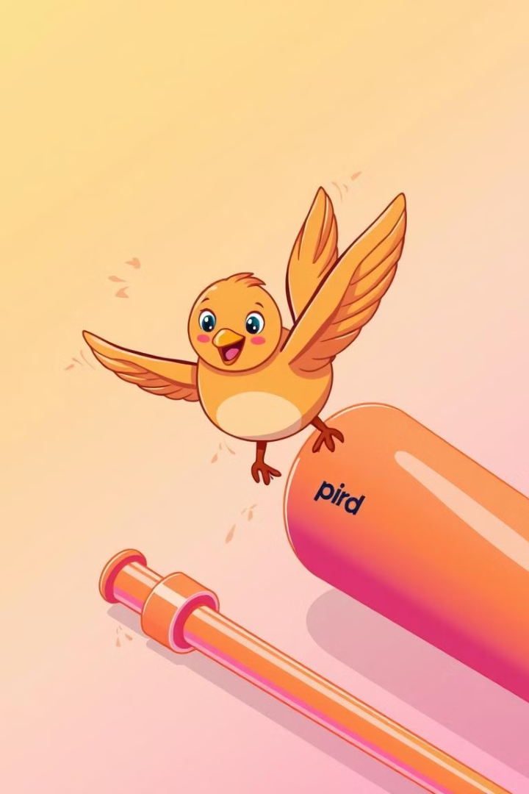
OBJECTS: INSTANCES OF CLASSES
Objects are created from classes, representing specific instances of the class. For example, the game creates multiple pipe objects, each with its own unique position and gap.
This allows for dynamic game elements, where each pipe object can move independently, creating a challenging and engaging gameplay experience.

Slide 13
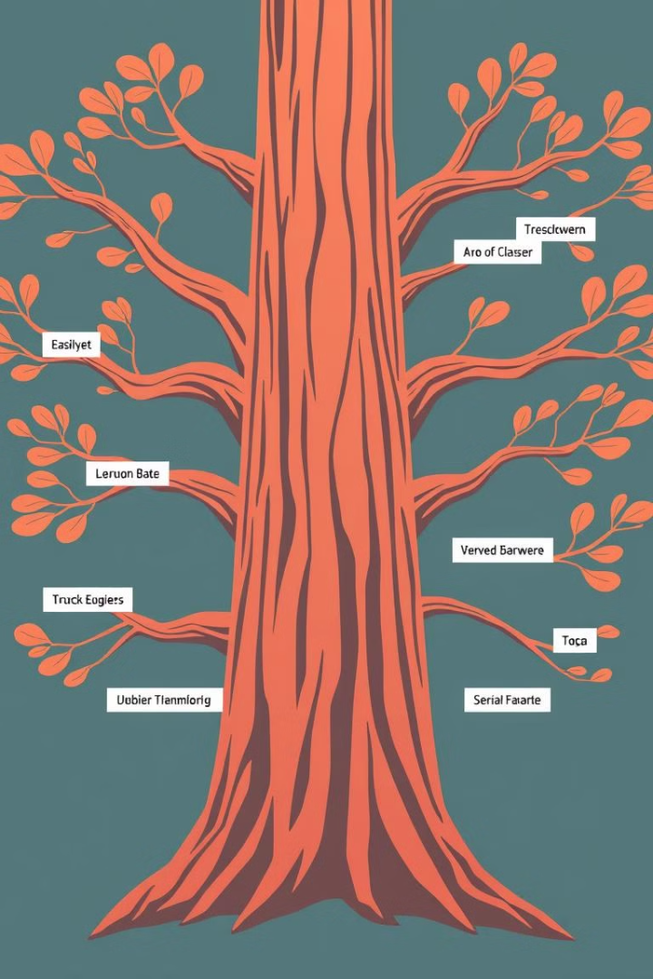
INHERITANCE: BUILDING UPON EXISTING CODE
Inheritance allows for creating new classes that inherit properties and methods from existing classes. This promotes code reuse and reduces redundancy.
For example, a "PowerUpPipe" class could inherit from the "Pipe" class, adding additional functionality like granting the bird temporary invincibility.

Slide 14
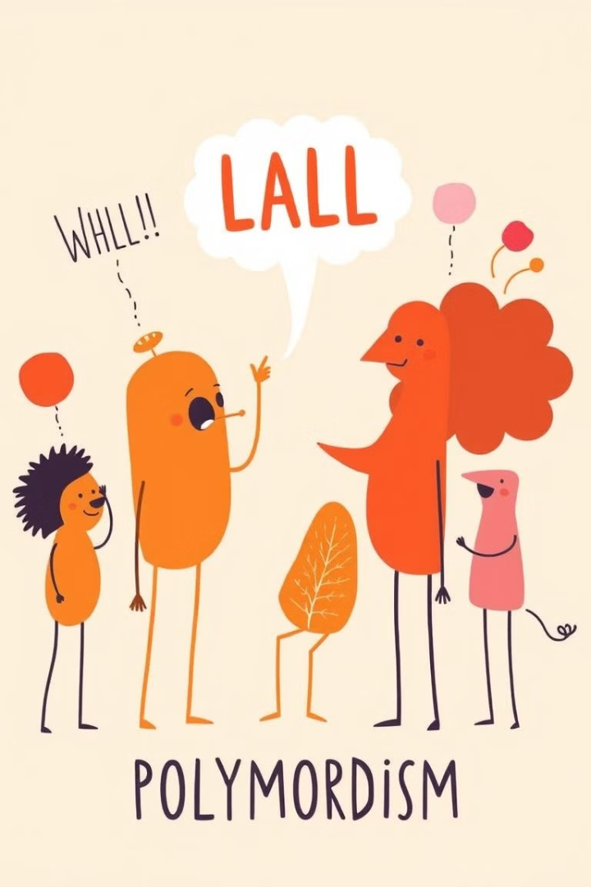
POLYMORPHISM: ONE METHOD, MULTIPLE FORMS
Polymorphism allows objects of different classes to respond to the same method call in their own unique ways. This promotes flexibility and adaptability in code.
For example, the "update" method could be called on both the "Bird" and "Pipe" objects, but each object would update its position and behavior differently.

Slide 15

ENCAPSULATION: PROTECTING DATA
Encapsulation hides internal data and implementation details of a class, exposing only necessary methods for interaction. This promotes data integrity and reduces the risk of unintended modifications.
For example, the "Bird" class could have private attributes like "velocity" and "flap_strength," accessed and modified only through public methods like "flap" and "update."

Slide 16

BENEFITS OF OOP IN FLAPPY BIRD
1
Modular Code
2
Reusability
OOP promotes modularity, making the code easier to understand, debug, and maintain.
Classes can be reused in other projects, saving development time and effort.
3
Flexibility
OOP allows for easy modification and extension of the game's functionality.

Slide 17
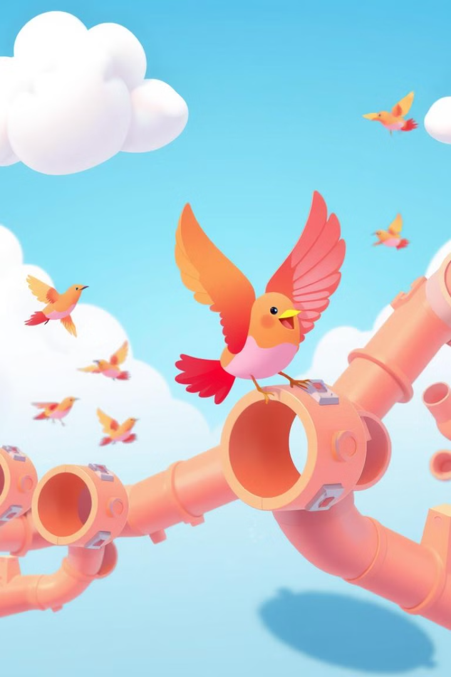
KEY TAKEAWAYS
OOP is a powerful paradigm that enhances code organization, reusability, and maintainability. By applying OOP principles, we can create more robust, flexible, and scalable game applications.
This Flappy Bird example demonstrates how OOP concepts like classes, objects, inheritance, and polymorphism can be effectively utilized to create a fun and engaging game experience.

Slide 18
INTRODUCING THE BIRD CLASS
Initialization
Key Attributes
The Bird class is initialized with a scale_factor to adjust the bird's size. It loads the bird's images for flapping up and down, scales them, and sets the initial position and velocity.
Key attributes include image, rect (position and size), velocity, update_on (determines if the bird is moving), and flap_strength.

Slide 19

GRAVITY IN ACTION
1
Constant Downward Force
The bird is affected by gravity, constantly accelerating downwards. This force is represented by the formula: F = mg, where F is
the force of gravity, m is the mass of the bird, and g is the acceleration due to gravity.
The velocity attribute is increased by 0.5 in each frame, simulating the acceleration due to gravity.

Slide 20
2. Updating Position
3. Jump
The bird's vertical position (y-coordinate) is updated based on the velocity. This creates a smooth falling animation as the bird moves downwards.
When the player taps the screen, the bird jumps upwards. This jump is modeled as an instantaneous change in velocity, overcoming the downward force of gravity. The jump velocity is a constant value, determined by the game's parameters.

Slide 21
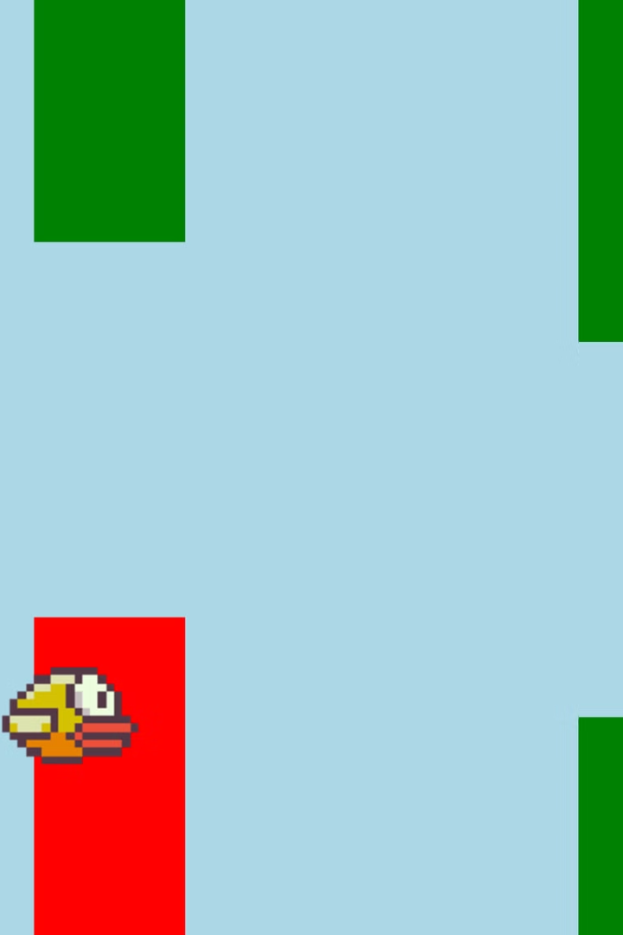
COLLISION DETECTION
Ground Collision
Pipe Collision
The bird collides with the ground when its bottom edge goes below a certain y-coordinate. This triggers the game over condition.
The bird collides with the pipes when its bounding box intersects with either the top or bottom pipe. This also triggers the game over condition.

Slide 22
FLAP MECHANICS
Flap Strength
Applying the Force
The flap_strength determines the upwards force applied when the bird flaps its wings. A higher flap strength results in a more powerful upward jump.
The flap() method sets the velocity to the flap strength, giving the bird an upward boost. This counters the effect of gravity and allows the bird to ascend.

Slide 23
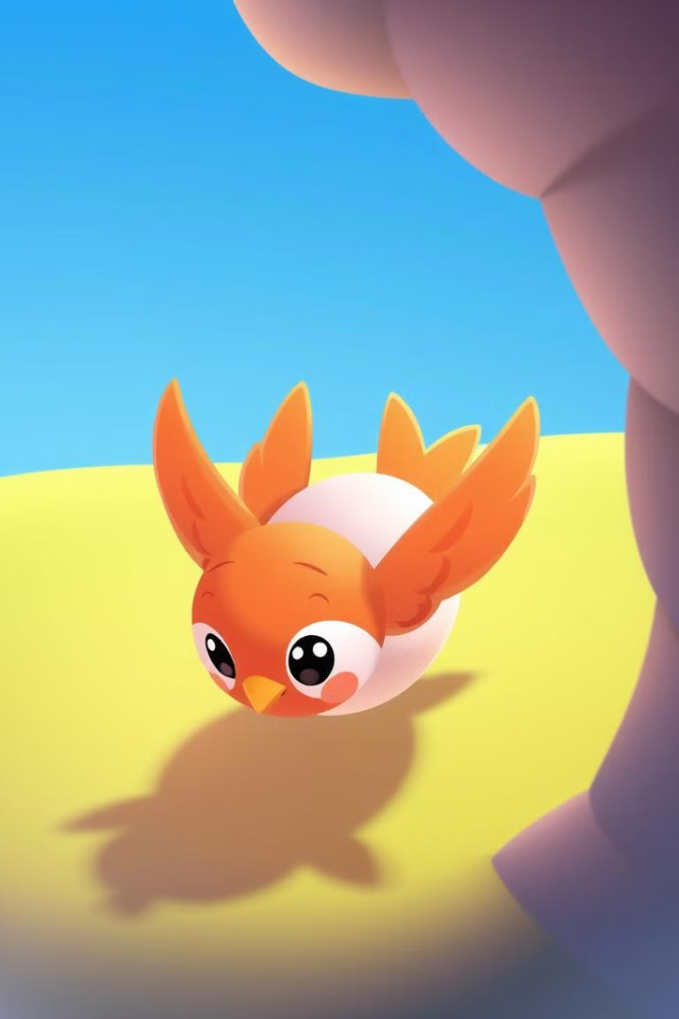
CONSTRAINING MOVEMENT
1
Top and Bottom Boundaries
2
Zero Velocity at Ground
When the bird hits the ground, its velocity is set to zero to prevent it from continuing to fall.
The bird's movement is constrained within the game window. If the bird hits the top or bottom of the screen, its position is reset to keep it within the bounds.

Slide 24
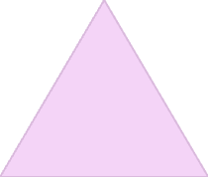
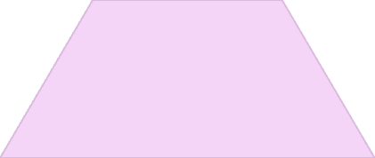


UNDERSTANDING THE PHYSICS
Gravity
1
A constant downward force acting on the bird.
Flap Force
2
An upward force applied by the bird's wings.
Velocity
3
The bird's speed and direction.
Position
4
The bird's location on the screen.

Slide 25
CALCULATING BIRD MOVEMENT
Newton's Second Law
Calculating Velocity
The bird's motion is governed by Newton's Second Law: F = ma, where F is the net force, m is the bird's mass, and a is the acceleration.
The bird's velocity is updated in each frame using the formula: v = u + at, where v is the final velocity, u is the initial velocity, a is the acceleration, and t is the time elapsed.

Slide 26
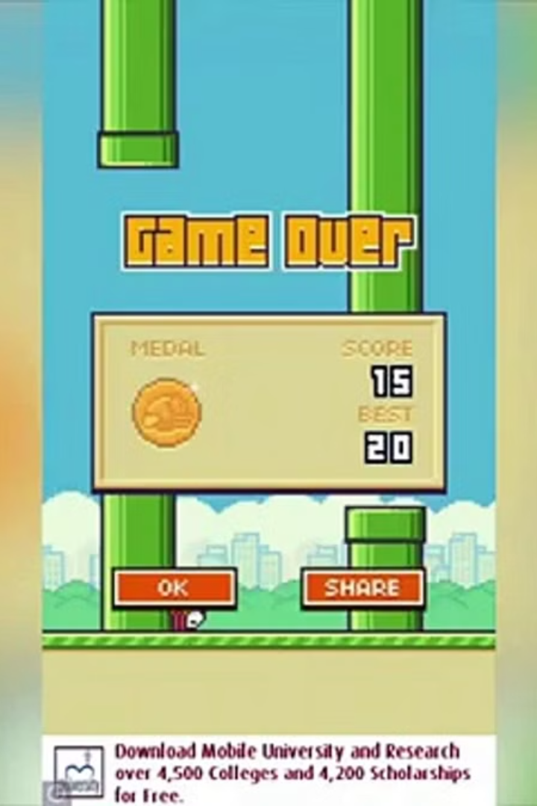

SCORING SYSTEM
Pipe Passage
The player earns a point each time the bird successfully passes through a pair of pipes. This is determined by checking if the bird's x-coordinate is greater than the right edge of the first pipe.

Slide 27
IMPROVING BIRD CONTROL
Adjust Flap Strength
1
Experiment with different flap_strength values to find the best balance between upward jump and control.
Add Air Resistance
2
Simulate air resistance by decreasing the bird's velocity slightly in each frame, creating a more realistic feeling.
Introduce Flapping Animation
3
Replace the static bird image with a series of images depicting different flapping positions to create a more dynamic animation.

Slide 28

LET’S FLY!
Now that we've explored the core physics of bird movement in our game, we have a foundation for creating a compelling and engaging flight experience. Remember to apply these concepts creatively, experiment with different physics parameters, and add animations to bring our bird to life.

Slide 29
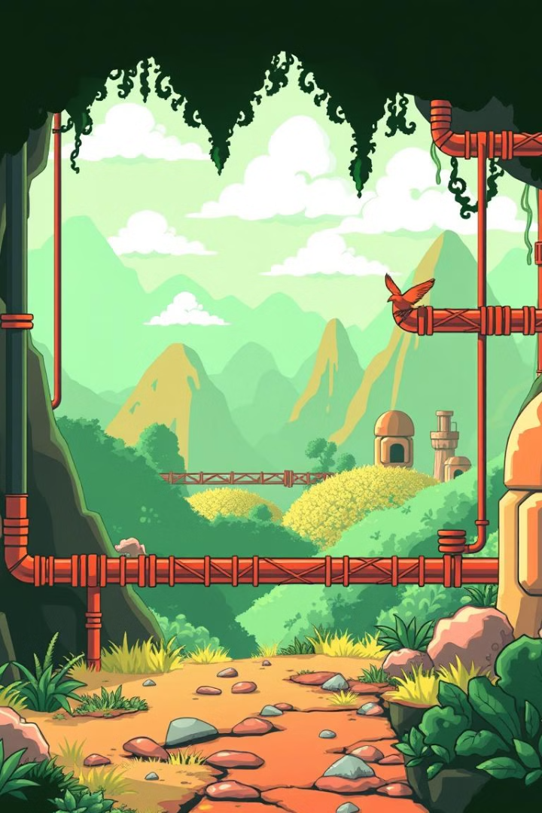
PYTHON GAME PHYSICS: BUILDING A PIPE SYSTEM
This explores the physics behind building a pipe system in a simple 2D game using Python and the Pygame library. We'll examine how to implement collisions, movement, and other aspects of game physics to create a dynamic and engaging environment for our game.

Slide 30
THE PIPE CLASS
Initialization
Drawing
The **init** method initializes the pipe object. It loads images for the top and bottom sections, creates rectangular collision areas, and defines the pipe's initial position and speed. The **pipe_gap** argument controls the vertical distance between the top and bottom pipe sections.
The drawPipe method draws the pipe object onto the game window using the preloaded images and collision rectangles. The images are placed according to the rect positions, creating the visual appearance of the pipe. It's a simple function, but crucial for rendering the pipe on the screen.

Slide 31
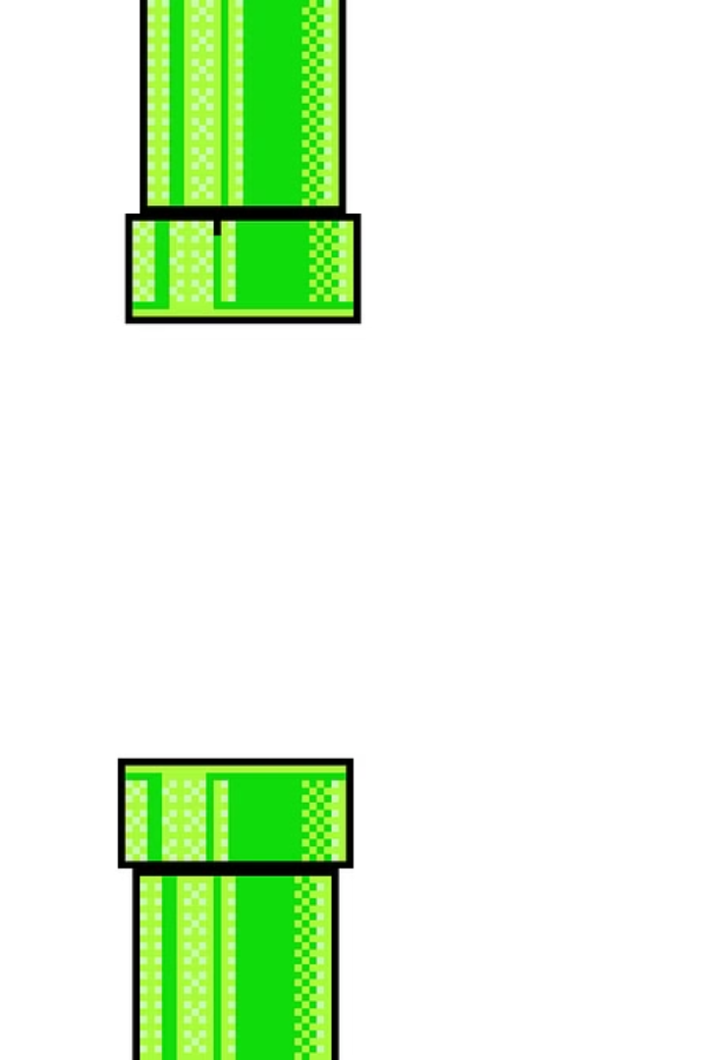
PIPE GENERATION
1
Interval
Pipes are generated at regular intervals, controlled by a counter that increments with each frame. When the counter reaches a certain threshold, a new pipe pair is created.
2
Position
The pipes are positioned randomly, with the top pipe's height varying to create different challenges. The gap between the pipes is also defined by a constant value.
3
Movement
The pipes move horizontally across the screen at a constant speed. Once they move off-screen, they are removed from the game.

Slide 32
PHYSICS: UNDERSTANDING MOTION
Constant Velocity
The Update Method
Pipes move at a constant velocity to the left, giving the player a sense of progression. We use the Pygame time module to ensure smooth movement regardless of the frame rate. The **move_speed** attribute controls the rate of horizontal movement. This movement is essential for the player's challenge, as the pipes approach, they need to navigate the gaps.
The update method handles the pipe's movement. It modifies the X-coordinate of both the top and bottom pipe rectangles by subtracting the **move_speed** multiplied by the time elapsed since the last update. This creates a smooth, consistent leftward motion.

Slide 33
COLLISION DETECTION
Rectangles
Simple Collision Check
Pygame's Rect objects are used to represent the boundaries of the pipes. They are rectangles, so their collision detection is straightforward. When the player's object's rectangle overlaps with the pipe's rectangle, a collision is detected.
Using the **rect.colliderect** method, we can easily check if the player's rectangle collides with either the top or bottom pipe rectangle. This simple method provides the basic logic for collision detection in our game. Collisions are an important element of game physics, determining whether the player interacts with game elements or the environment.

Slide 34

CALCULATING MOTION
1
Velocity
2
Displacement
The pipe's velocity, which is the rate of change in its position, is constant. The pipe moves at a steady speed to the left, represented by the **move_speed** variable.
The displacement is the change in the pipe's position. It's calculated by subtracting the initial X-coordinate from the final X-coordinate after each update. The displacement is directly proportional to the pipe's velocity and the time elapsed.
3
Acceleration
In this case, the pipe's acceleration is zero, meaning it's moving at a constant velocity. There are no forces acting on the pipe to change its speed or direction. This is an example of constant velocity motion.

Slide 35
THE GAP BETWEEN PIPES
The Importance of the Gap
Determining the Gap
The gap between the top and bottom sections of the pipe is crucial for gameplay. It provides a space for the player to pass through, challenging their skills and requiring precise timing.
The **pipe_gap** variable controls the vertical distance between the top and bottom pipes. This value is set when the pipe object is created and can vary depending on the difficulty level of the game.

Slide 36



RANDOMLY GENERATED GAPS
Adding Variety
The Implementation
Randomizing the gap between pipes creates a more dynamic and challenging gameplay experience. It prevents players from simply memorizing the gap positions and forces them to react to unpredictable changes in the environment.
The **randint** function from Python's **random** module is used to generate a random Y-coordinate for the top pipe. This randomness influences the gap size, as the bottom pipe's Y-coordinate is calculated based on the top pipe's position and the **pipe_gap** value.

Slide 37
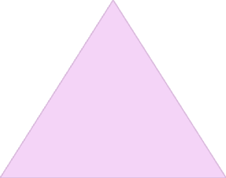


CHALLENGES AND CONSIDERATIONS
Collision Detection Accuracy
1
Precise collision detection is essential to ensure that players only collide when they actually come into contact with the pipes. This requires careful consideration of the size and position of the collision rectangles.
Pipe Generation
2
The game must generate new pipes as the player progresses. This requires careful timing and planning to avoid creating insurmountable obstacles or overly easy sections. The pipe generation algorithm should be balanced for difficulty and engagement.
Game Difficulty
3
The game's difficulty should be balanced to provide a challenging but enjoyable experience for players. This can be achieved by progressively increasing the pipe speed or decreasing the size of the gaps between pipes.

Slide 38
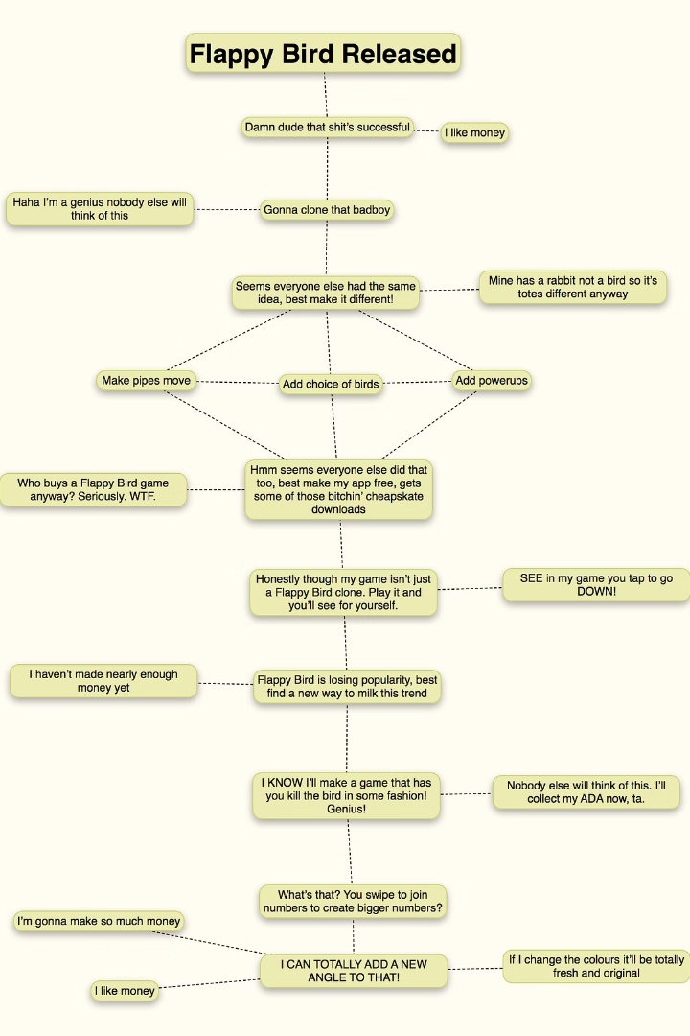
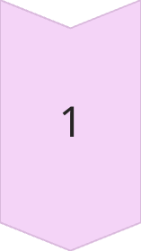
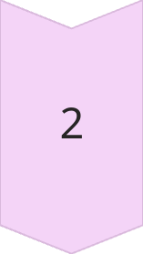
GAME LOOP
Update
The game loop updates the state of the game, including the bird's position, pipe movement, and collision detection. This is done at a fixed rate, typically 60 frames per second.
Draw
After updating the game state, the game loop draws all the elements on the screen, including the bird, pipes, background, and score. This creates the visual representation of the game.

Slide 39



GAME OVER
1
Collision
2
Bird Stops
3
Game Over Screen
When the bird collides with the ground or pipes, the game over condition is triggered. The bird stops moving, and a game over screen is displayed, typically showing the final score and an option to restart the game.

Slide 40
USER INPUT
1
Tap
2
Bird Jumps
3
Gravity Acts
The player interacts with the game by tapping the screen. Each tap causes the bird to jump upwards, defying gravity for a brief moment. This simple input mechanism is the core of the game's gameplay.

Slide 41
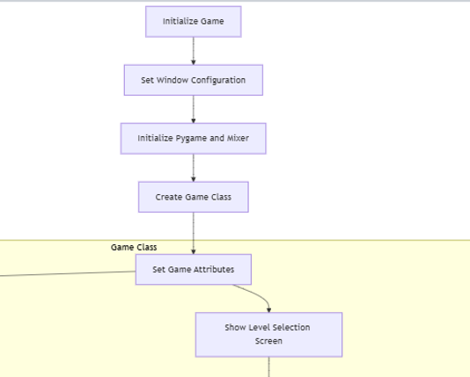
FLOWCHART

Slide 42
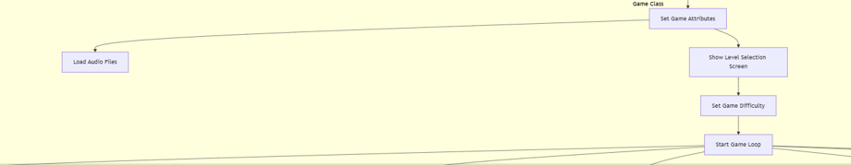

Slide 43
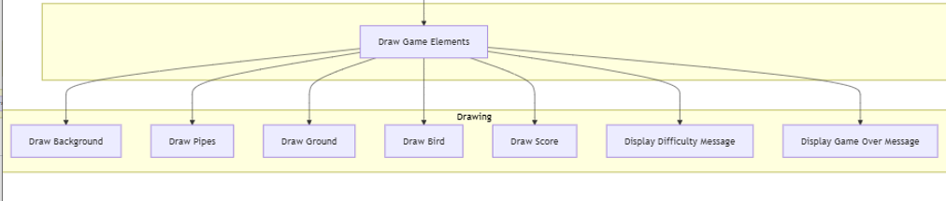

Slide 44
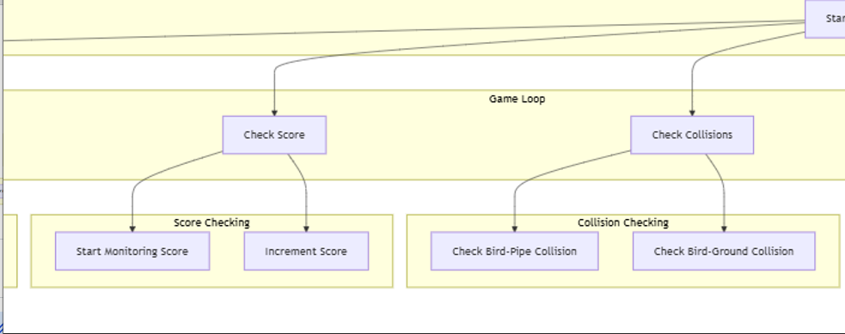

Slide 45
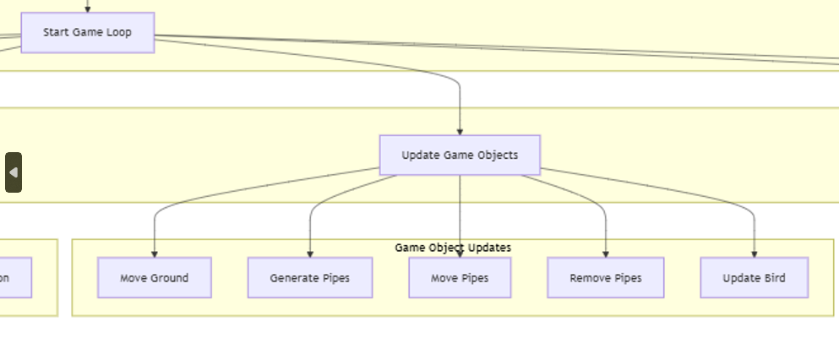

Slide 46
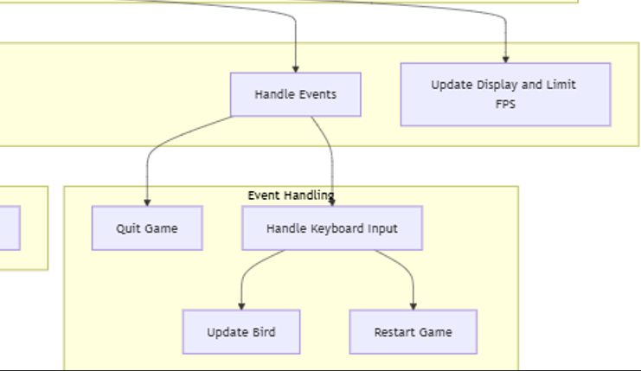

Slide 47
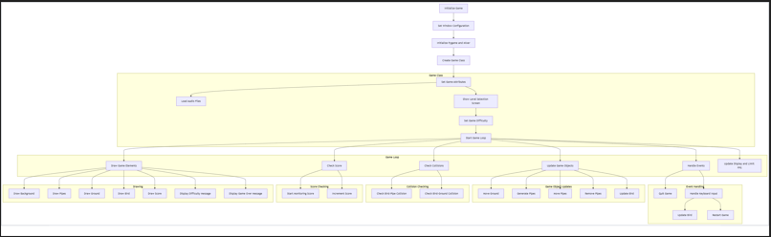
FULL FLOWCHART

Slide 48

CONCLUSION
In conclusion the development of the flappy bird game demonstrated key programming concepts like object-oriented design, physics simulation, event handling. Using python’s pygame library , we successfully created an interactive game with gravity, pipe generation and collision detection. This project highlights the importance of modular coding, offering offering a strong foundation for future game development and further enhancements.

